Slide 1
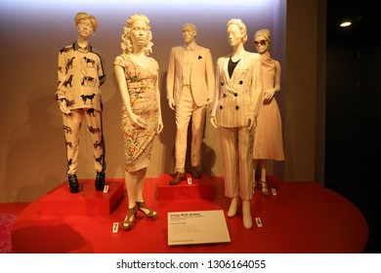
The Cute Corner Fashion & Design Institute
Agenda
  Goals
  Purpose
  The Future
  What I Need

Slide 2
Goals
Develop an academic background that nurtures professional and intellectual development of students
Establish and maintain a dedication to academic activities in creativity and research by the use of technology
Provide quality certificate courses that give the required basics for the students’ career goals.

Slide 3
Purpose
Providing opportunities to community students talented in fashion and design
Incorporating less privileged students in the society
Creating job opportunities for the residents
Producing locally trained fashion designers
Building community identity

Slide 4
The future
This institute aims beyond offering fashion design courses
The institute aims at adding more courses including
  Leather design
  Textile design
  Beauty and cosmetics
The institute also aims at future expansion to offer diploma, bachelors, and masters courses.

Slide 5
What we Need
Funding for construction of the institute
Support in learning materials
Bursaries/scholarships for needy students
Funding to hire well qualified and experienced tutors

